Slide 1
Carduino Finish Line Timer
Embedded Systems Lab Training
RCSE 2019
Kiran Gosavi
Gordon Ohawa
Rajiv Ponnathpur
Supervisor:
Alexander Wichmann
1

Slide 2
System Idea
A timing system for:
Detecting when an object crosses a finish line
Output the time between the intervals
Object could be a car moving in a lap race
2

Slide 3
System Layout
Laser transmitter and a detector positioned parallel and facing each other
Connected to an Arduino via breadboards
The detector should detect any slightest obstruction of the laser- object detected
Current and previous detection intervals are displayed on the screen
3

Slide 4
Applications
Break beam timing system in athletics for testing individual athletes best time
Object detection in security installations. In this case an alarm is triggered when an object is detected
Circuit car racing for recording the best time in each lap
4

Slide 5
Hardware Requirements
Arduino Uno Board
Breadboard
Colored LCD
Laser transmitter
Laser detector
2 breadboards
Arduino shields
Jumper wires
6

Slide 6
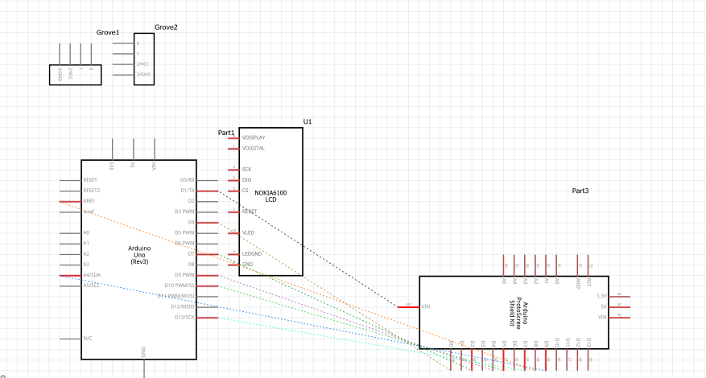
Schematic Diagram
6

Slide 7
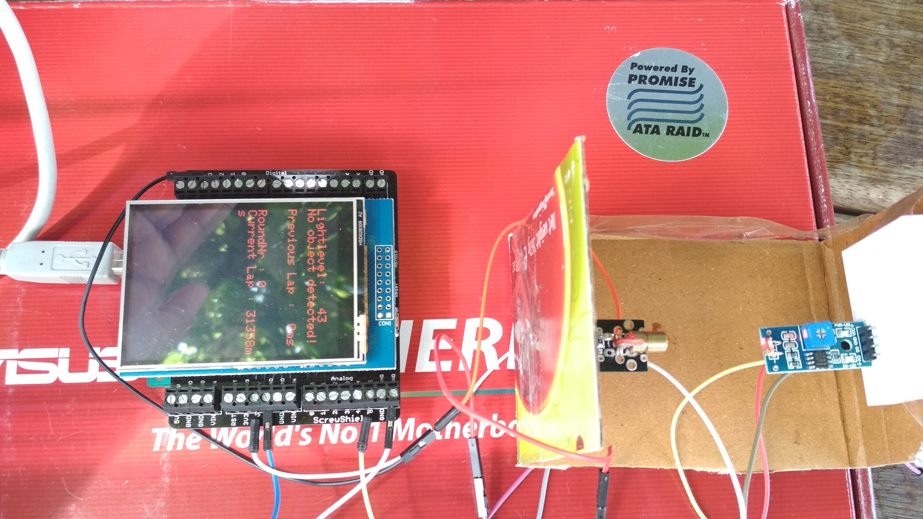
Breadboard arrangement
7

Slide 8
Demonstration
9

